Slide 1
How to Create an Industry Go to Market Approach
Bill Penczak
Managing Director
Practice Development

Slide 2
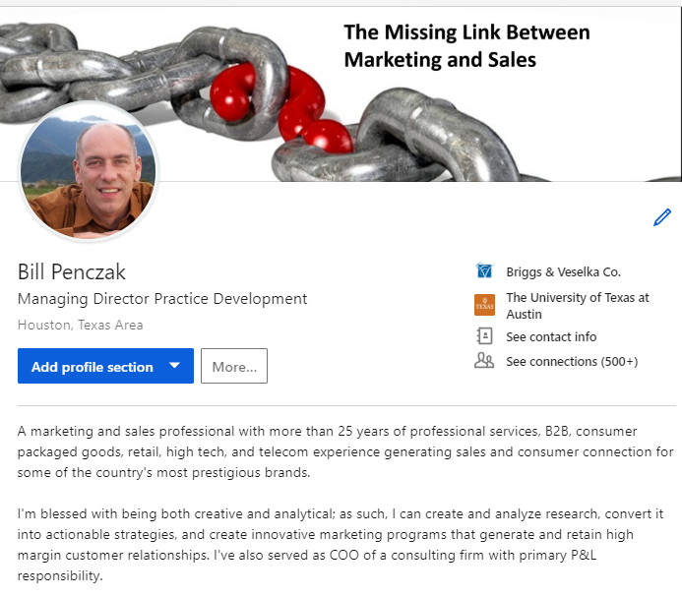

Slide 3

Firm Evolution
Tax Only Tax & Audit Ancillary Services Industry Approach Industry with Svc Subs
1-5 5-25 25-200 200+ 2000+

Slide 4

Why An Industry Approach Works for Smaller Firms
Differentiates you from other firms
Provides an organizational platform
  For marketing to be more than a service bureau
  To coordinate go to market approach
  Teaching tool for your younger people
Accountability across the board
  That includes you, the marketing person

Slide 5

How We Started
Year 1
One fully formed group
Service lines
  EBP, SALT, International Tax, Outsourced Accounting, TAS
Year 2
Add process and structure
Add Construction, Manufacturing

Slide 6

Lessons Learned in Years 1-2
Needs to be cross functional
Practice leader is essential—marketing has neither carrots nor sticks
Plow through when it gets ugly, especially in 2nd-3rd month
Untapped talent in the firm
Lubricant and irritant

Slide 7

Talent Inventory
All firm survey completed in conjunction with HR
Current or past capabilities-technical
Current or past industry experience
Future goals and desired skills
Team assignments
  Skills
  Contacts

Slide 8

Today: Components of Niche Go to Market Approach
Business Plan
Sales pipeline
Top 20 list
Marketing Calendar
K.I.S.S.

Slide 9

Business Plan Comes First
Objectives
Tactics
Measurement
Who’s responsible

Slide 11
Keys to Successful Business Plan
Leadership needs to own it; marketing can facilitate and be the reminder/keeper
Multi-disciplinary (audit, tax, specialty)
Quarterly reviews with leadership (marketing isn’t the cop here)
Tie KPIs (including yours) to performance review
We’ve now completed 18 business plans for service lines, industries, geographies and for our strategic services departments

Slide 12
2019 B&V Firm Growth Channels
Lost Proposals
Current Clients
Shareholders
Prospects in the database
Net New
Marketing & Niche leaders
Referral Sources
Marketing & Shareholders

Slide 13

Prospects in database: Top 20 List
Cross Serve
Greenfield
  Business Journal list
  Hoovers list
  Industry organization
No such thing as cold call
Each has owner(s)
Monthly report
20 is optimal size if you have 4-5 team members

Slide 14

“No Such Thing as a Cold Call”
Referral sources
  Aggregated list
  Individual conversations
  Linked In Sales Navigator
  Linked In Savant or power user

Slide 15
Sales Pipeline
Target
Prospect
Qualify
Propose
Win

Slide 16

Monthly Pipeline Report
Wins and losses
Open Proposals
Qualified
Prospect
Target
Maintain during meetings
Celebrate wins
Commonly address approach
Tabulate YTD

Slide 17
Sample Pipeline

Slide 18

Marketing Calendar
Events
Email
Sponsorships
Client satisfaction
Monthly pipeline meetings
As much for marketing as much as professionals

Slide 19

How to get started
Leadership/managing partner buy-in (let me help)
Industry leader
  Partners NOT always the best candidate to lead
Multi-disciplinary approach
Process driven

Slide 20
Contact Me
Business Plan template (CEO Tools 2.0)
Pipeline template
Top 20 list
Pipeline meeting agenda
Coaching or a shoulder to cry on via phone
Parachute in

Slide 21

Questions?

