Slide 1
High Net Worth Estate Planning
BKR Worldwide International
FEBRUARY 17, 2021
PRESENTED BY: BRANDON D. HAMM

Slide 2

Bio
Areas of Practice
Estates & Trusts
Business Succession Planning
Wealth Transfer Planning
Charitable Planning
Education
J.D., Creighton University, 2005, magna cum laude
M.B.A., University of Nebraska at Omaha, 2002
B.S., Truman State University, 1998, magna cum laude
Chartered Advisor in Philanthropy® (CAP®), The American College of Financial Services, 2014
Certified Exit Planner (CExP™), Business Enterprise Institute, 2018
Recognition
American College of Trusts & Estates Council, Fellow, 2019
Recognized for Private Wealth Law by Chambers High Net Worth Guide, Band 1 Attorney in Private Wealth Law, 2017-Present
Best Lawyers in America (© Woodward / White, Inc.), Trusts and Estates, 2018-Present
"AV" Rating, Preeminent, Martindale-Hubbell
Brandon Hamm
Shareholder and Chair of the Estate, Succession and Tax Department
Brandon.Hamm@KoleyJessen.com
402.343.3840

Slide 3
Agenda
Current Wealth Transfer Tax Provisions (TCJA)
Biden’s Proposed Changes
Statistics
Illustrations
Wealth Transfer Planning

Slide 4

The Tax Cuts and Jobs Act of 2017

Slide 5
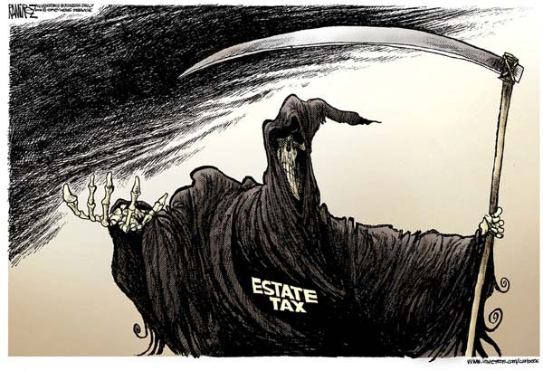
Transfer Taxes
Federal transfer taxes
  Estate tax
  Gift tax
  Generation-skipping
State transfer taxes
  Estate tax
  Gift tax
  Inheritance tax
  Other?

Slide 6
Federal Estate Tax
Tax on the right to transfer property at death
No tax on property left to charity or spouse
Exemption amount
  2017 exemption = $5.49M
  2021 exemption = $11.7M
Tax Rate = 40%
“Stepped-up” basis

Slide 7
Federal Gift Tax
Tax on gratuitous lifetime transfers of property
Small gifts: annual exemption amount
  $15,000 per donee
Large gifts: lifetime exemption amount
  2017 exemption = $5.49M
  2021 exemption = $11.7M
Tax Rate = 40%
“Carry-over” basis

Slide 8
Federal GST Tax
Tax on transfers during life or at death to person assigned to a generation two or more below transferor
Small gifts: annual GST tax exclusion
  $15,000 per done
Large gifts: GST tax exemption amount
  2017 exemption = $5.49M
  2021 exemption = $11.7M

Slide 9
Portability
Election that allows a deceased spouse’s unused estate tax exemption to be allocated to surviving spouse for possible use at subsequent death
Retained under the Tax Cuts and Jobs Act
Applies to estate tax exemption
Does not apply to GST tax exemption

Slide 10
TCJA Sunset Provisions
Increased exemptions under TCJA expire on 12/31/2025
On 1/1/2026, exemptions revert to $5M per person, as indexed since 2011
  Estimated exemption in 2026: $6.2M
Will Congress make changes sooner?

Slide 11
Federal Estate Tax
*Projected Exclusion Amounts

Slide 12
Exemption Amounts
*Projected Exemption Amounts
Note: As of 1/1/10, the estate and generation-skipping transfer (GST) taxes were repealed for 2010. On 12/17/10, the 2010 Act retroactively reinstated both taxes for 2010, with a $5M exclusion / exemption for each, a top estate tax rate of 35% and a 0% GST tax rate. Taxpayers were given a choice to have estate tax apply and receive basis adjustment, or not apply and have carry-over basis.

Slide 13
Potential Changes to Wealth Transfer Taxes

Slide 14
Biden’s Proposals
Reversion to 2009 laws
  Reduce the estate tax exemption to $3.5M
  Reduce the gift tax exemption to $1M
  Increase the rate to 45%
Eliminate stepped-up basis

Slide 15
Statistics

Slide 16
Estate Tax Return Statistics
 | 2009 | 2016 | 2017 | 2018* | 2019* | 2020* | Biden Proposal
Exemption | $3.5 M | $ 5.45 M | $ 5.49 M | $ 11.18 M | $ 11.4 M | $ 11.58 M | $3.5 M
Decedents | 2.39 M | 2.74 M | 2.81 M | 2.83 M | 2.85 M | 3.1 M | ?
Estate Tax Returns | 33,515 | 11,783 | 12,455 | 4,000 | 4,100 | 4,100 | ?
Percent Taxable | 43.9% | 44.0% | 44.0% | 47.5% | 46.3% | 46.3% | ?
Estate Tax Paid | $13.5 B | $ 19.40 B | $ 20.18 B | $ 14.9 B | $ 15.6 B | $16.0 B | ?
% of Population Paying Estate Tax | 0.62% | 0.19% | 0.20% | 0.07% | 0.07% | 0.06% | ?
Sources:
Internal Revenue Service, Statistics of Income Division. “SOI Tax Stats - Estate Tax Year of Death Tables”
Urban-Brookings Tax Policy Center
* Projections

Slide 17
Gift Tax Return Statistics
 | 2009 | 2016 | 2017 | 2018 | 2019* | 2020* | Biden Proposal
Exemption | $1.0 M | $ 5.45 M | $ 5.49 M | $ 11.18 M | $ 11.4 M | $ 11.58 M | $1.0 M
Gift Tax Returns | 234,714 | 242,585 | 239,590 | 235,893 | 230,000 | 230,000 | ?
Percent Taxable | 4.57% | 1.12% | 1.20% | 0.91% | 0.90% | 0.87% | ?
Gift Tax Paid | $2.74 B | $ 2.13 B | $ 1.73 B | $ 833 M | $ 830 M | $ 828 M | ?
Sources:
Internal Revenue Service, Statistics of Income Division. “SOI Tax Stats – Total Gifts”
* Projections

Slide 18
Illustrations

Slide 19
Illustration 1: Current Exemptions
Presume:
$11.7M Exemption
40% Rate
H&W die in same year
Gross Estate | $35.0 M
Combined Exemptions | $23.4 M
Net Taxable Estate | $11.6 M
Estate Tax Due | $4.64 M
Net Estate | $30.36 M

Slide 20
Illustration 2: Proposed Exemptions
Presume:
$3.5M Exemption
45% Rate
H&W die in same year
Gross Estate | $35.0 M
Combined Exemptions | $7.0 M
Net Taxable Estate | $28.0 M
Estate Tax Due | $12.6 M
Net Estate | $22.4 M

Slide 21
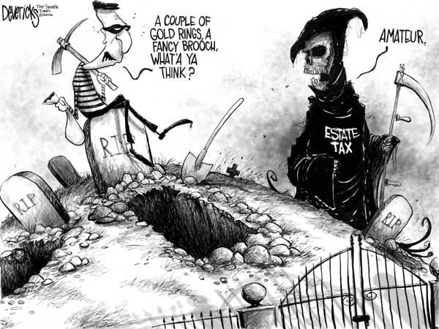
Federal Estate Tax

Slide 22
Illustration 3: Stepped-Up Basis
Presume:
BRK-A Basis $7K
BRK-A DOD Value $361,290*
Sell on date of receipt
Sale Price | $361,290
Basis | $361,290
Gain | $0
Federal Capital Gains Tax | $0
Nebraska Capital Gains Tax | $0
Nebraska Inheritance Tax | $3,213
Total Tax | $3,213
*2/10/2021 Value

Slide 23
Illustration 4: Carry-Over Basis
Presume:
BRK-A Basis $7K
BRK-A DOD Value $361,290*
Sell on date of receipt
Sale Price | $361,290
Basis | $7,000
Gain | $354,290
Federal Capital Gains Tax | $113,373
Nebraska Capital Gains Tax | $24,233
Nebraska Inheritance Tax | $3,213
Total Tax | $140,819
*2/10/2021 Value

Slide 24
Wealth Transfer Planning

Slide 25
Overview of the IDGT
Intentionally Defective Grantor Trust
Irrevocable wealth transfer trust
Designed to leverage wealth transfer capabilities
Typically utilizes some or all of client’s estate and gift tax exemption
Can include a spousal interest

Slide 26
Overview of the IDGT
Can be designed as “dynasty trust” where assets remain in trust for generations
Initially set up as “grantor trust”
  IDGT income flows through to grantor who pays tax
  Grantor’s payment of IDGT taxes not additional gifts
  Transactions between grantor and IDGT do not trigger tax consequences

Slide 27
Sale to IDGT Strategy
Often completed with business-owner client in advance of sale of business
Client forms IDGT
Client makes “seed” gift to IDGT, utilizing some or all of client’s gift exemption
Client sells assets to IDGT in exchange for a note
Assets sold to IDGT sold at discounted values to leverage wealth transfer capabilities

Slide 28
Sale to IDGT Strategy
IDGT assets not used to repay note passes to IDGT beneficiaries
Commonly referred to as estate “freeze” technique
  Exchanged rapidly appreciating and/or income-producing assets for note accruing interest at low/fixed interest rate
  Client freezes value of estate by moving future appreciation / income on assets that are gifted / sold to IDGT out of client’s “taxable” estate

Slide 29
Leveraging Capabilities
Grantor trust status
  Trust where “grantor” (i.e., the person who creates the trust) is responsible for paying income tax on trust’s income
  Created if certain provisions are included in trust that trigger the grantor trust tax code sections
    I.R.C. § 671-679

Slide 30
Leveraging Capabilities
Grantor trusts
  Why is this important?
    Grantor treated as owner of trust assets for income tax purposes and all income is taxed to grantor
    Grantor’s payment of income taxes:
      Further minimizes grantor’s “taxable” estate
      Is not considered additional gifts for gift tax purposes
        Rev. Rul. 2004-64, 2004-2 CB 7
    Transactions between grantor and trust do not trigger income tax consequences

Slide 31
Leveraging Capabilities
Use of valuation discounts
  Recapitalize company to create voting and nonvoting interests
    1,000 voting interests / 99,000 nonvoting interests
  Benefits
    Generates lack of control discount for nonvoting interests
    Allows control to remain with owner of voting interests and value to be transferred with nonvoting interests

Slide 32
Sale to IDGT Strategy
  Step 1 – The Gift Transaction: Client establishes IDGT and transfers “seed” gift not exceeding $11.7 M in value.
  Step 3 – Distribution of IDGT Assets: Interests gifted / sold to IDGT (or their proceeds from sale), and future appreciation, less the payments under the note are held for benefit of beneficiaries.
Gift of Assets
Client
IDGT
Beneficiaries (i.e., spouse, children, others)
Sale of Assets
Promissory Note
  Step 2 – The Sale Transaction: Client sells nonvoting interests to IDGT in exchange for promissory note calling for payment over a set period (e.g., 9 years) and interest accruing at “Applicable Federal Rate.” Note will be paid using income received by IDGT from gifted / purchased interests and/or proceeds from IDGT’s eventual sale of interests.

Slide 33
Sale to IDGT Strategy
Practical Impact
Net IDGT value not included in estate, but rather held for benefit beneficiaries
Income and appreciation on Business Interests (or proceeds from their sale)*
Business Interests
(or proceeds from their sale)
IDGT “Net” Value
Interest received on Note (e.g., February 2021 Mid-Term AFR = 0.56%)
Tax-free cash/in-kind payments received by Grantor included in estate
Grantor’s “Estate”
Cash Payments Received
Outstanding balance on Note goes down as IDGT uses business income to pay down principal
Promissory Note Receivable
Date of Sale
* - Assumes assets transferred appreciate at rate greater than interest paid under the Note
Year 9

Slide 34
Sale to IDGT Strategy
“Seed” gift
  Gift should equal or exceed 10% of expected value of eventual sale to IDGT
  Gives IDGT “financial wherewithal” to complete purchase of assets from client
  Reduces risk that sale will be treated as § 2036 transfer with retained interest causing estate inclusion

Slide 35
Sale to IDGT Strategy
Powerful, flexible and scalable
Flexibility is critical
  Spousal interest (where possible)
    Not direct transfer to descendants
    Distributions of income / principal available to spouse
    Distributions to spouse can find their way back to grantor
  Power of substitution
    Allows grantor to take back assets at any time
    Can regain control over IDGT assets and their income

Slide 36
Sale to IDGT Strategy
IDGT assets are exempt from:
  Transfer taxes
  Claims of beneficiaries’ creditors
Flexibility is critical
  Powers of appointment
    Allow someone other than grantor to change IDGT terms
    Can be held by spouse
    Changes can be typically only be made among descendants, spouses/widows/widowers of descendants, and/or charities

Slide 37
Sale to IDGT Strategy
Controlling the client’s income tax burden
  Spousal distributions
  Investment of IDGT assets
  Income tax reimbursement provision
  Additional sales of assets to IDGT
  Power of substitution
  Turn off grantor trust status of IDGT

Slide 38
Process
Sale to IDGT process:
  Determine tax and non-tax objectives
  Recapitalize company into voting/nonvoting interests
  Form IDGT
  Obtain appraisal of nonvoting interests
  Gift / sell nonvoting interests to IDGT
  Gift tax return
Usually will take 2-3 months to design and implement

Slide 39
Process
Timing is critical
  Planning should be done as far in advance of sale as possible
  As soon as client expresses interest in eventual sale of business, wealth transfer planning effort should begin
  Adequate time between wealth transfer planning effort and business sale reduces risk
  Once letter of intent is signed, planning opportunity is significantly diminished

Slide 40
Illustration 5: Funding IDGTs
Presume:
$11.7M Exemption
40% Rate
Growth of 5%
Settlor dies 15 years after transfer
Amount of Gifts to Two IDGTs (H&W) | $23.4 M
Gift Tax Due | $0
Combined Value After 15 Years | $48.6 M
Taxable Estate for Same Securities Not Placed in IDGTs (After 15 Years) | $48.6 M
Estate Tax Due | $19.4 M

Slide 41
Thank You!
BKR Worldwide iNTERNATIONAL
FEBRUARY 17, 2021
PRESENTED BY: BRANDON D. HAMM
Presentation Disclaimer: This presentation should not be considered as legal, tax, business, or financial advice. This presentation is intended for educational and informational purposes only. It is provided with the understanding that while the author is a practicing attorney, neither she nor Koley Jessen have been engaged by the attendee/reader to render legal advice or other professional services. If legal advice or other expert assistance is needed by the attendee/reader, the services of a competent professional should be sought.

