Slide 1
BKR International AAM 2021 Summit Presentation
Key Takeaways & Best Practices

Slide 2
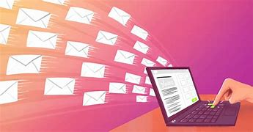
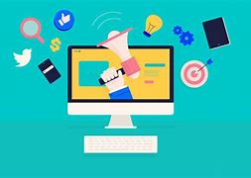
Email Marketing & Digital Content Marketing

Slide 3
Email Marketing Takeaways & Best Practices
Maintain a high-quality contact list
Your contact list is key to your email campaigns
Key to keep bounces low
Email reputation
Monitor the right metrics
KPIs are measurable and give instant feedback
Email marketing platforms and tools give you access to these analytics
Bounces, Open rate, Click through rate, Unsubscribes, Spam complaints
Design for engagement
Keep it brief
Have a clear call to action
i.e. Direct to website

Slide 4
Email Marketing Takeaways & Best Practices
Email Content
Make your content clear & direct in what you want the reader to pick up
Stay relevant with helpful information
How often you communicate depends on the message
Get personal
Segment your contacts
Specificity is important
Send from Partner or Relationship Manager
Newsletter content is important to consider
Timing is important
Resend emails with a low open rate
Take next steps
Target the people who click

Slide 5
Digital Campaigns & Content Marketing Takeaways & Best Practices
Content is a necessary aspect of modern-day marketing.
Know your owned channels
Website vs. Social Media
Identify KPIs
Segment your content posts
“Content buckets”
Social Media Strategy
Leverage your employees
Social media plays the biggest role in a buyer’s awareness & interest stages
Integrate social media with your larger marketing plan

Slide 6
Digital Campaigns & Content Marketing Takeaways & Best Practices
Monitor the right metrics
KPIs are similar to email campaigns: clicks, conversion, views
Make sure you are evaluating your performance
Analyze what pages and posts are getting the most traffic.
Create content based off these
Analyze competitors
Benchmark against yourself

