Slide 1
New Administration:
HUD / Affordable Housing Plan

Slide 2
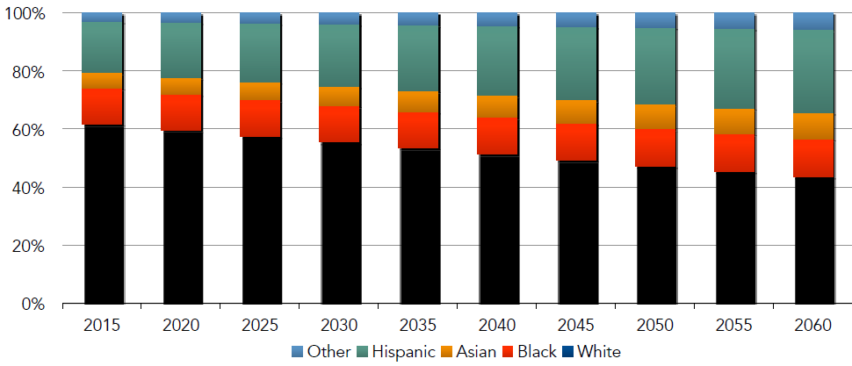
Demographics Shift: Collective Minority Becomes the Majority
Source: Census Bureau, 2014, and Mark Flemming, First American Presentation to AREAA

Slide 3
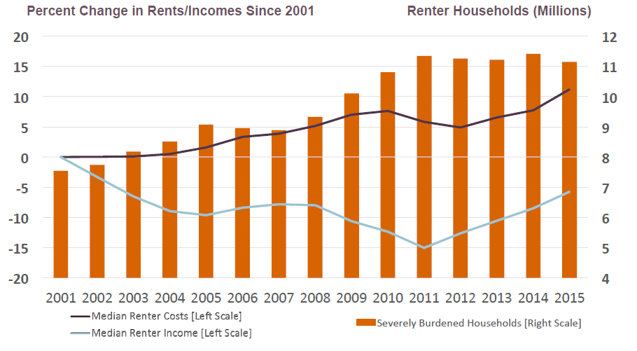
Severely Cost-Burdened Renters Rose Sharply in 2000s as Incomes have not kept pace with Rent Gains
Source: JCHS tabulations of US Census Bureau, American Community Surveys

Slide 4
HUD Budget Amts in Millions
HUD BUDGET | FY 2015 Enacted | FY 2016 Enacted | Senate FY 2017 THUD Bill | House FY 2017 THUD Bill | President’s FY 2018 Proposed
Housing Choice Voucher | $19,304 | $19,628 | $20,431 | $20,189 | $19,300
Project Based Section 8 | $9,730 | $10,620 | $10,901 | $10,901 | $10,816*
Public Housing Operating Fund | $4,440 | $4,500 | $4,675 | $4,500 | $3,269
Public Housing Capital Fund | $1,875 | $1,900 | $1,925 | $1,900 | $1,265
Section 202 | $420 | $433 | $505 | $505 | $463
Section 811 | $134 | $150 | $154 | $154 | $125
HOPWA | $330 | $335 | $335 | $335 | $335*
CDBG | $3,000 | $3,000 | $3,000 | $3,000 | $0
HOME | $900 | $950 | $950 | $950 | $0
Homeless Assistance | $2,135 | $2,250 | $2,330 | $2,487 | $2,664*
Choice Neighborhood Initiative | $80 | $125 | $80 | $100 | $0
Overall | $45,372 | $46,978 | $48,434 | $47,955 | $38,237
Source: OMB & The Washington Post

Slide 5
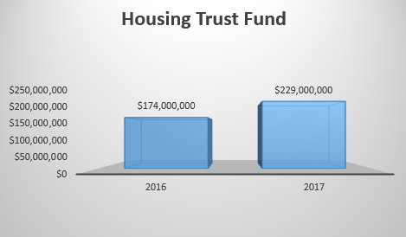
Housing Trust Fund: 2016 vs 2017 (Projected)
Source: Novogradac & Co. LLP

Slide 6
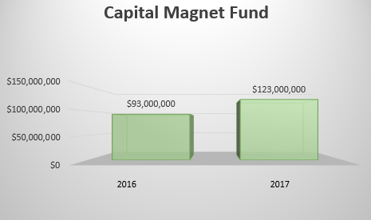
Capital Magnet Fund: 2016 vs 2017 (Projected)
Source: Novogradac & Co. LLP

