Slide 1
Recognizing & Combatting Unconscious Bias
delivered by Bonnie Buol Ruszczyk, bbr companies

Slide 2
Let’s Create a Safe Environment
Be present
Be open-minded and curious
Notice and let go of defensive or protective responses
Be compassionate
Be humble
Recognize looking inward is hard, but worth it

Slide 3
Have You Ever Heard…
We don’t see color at our firm
I haven’t seen or heard anything myself
Minority candidates aren’t as qualified
This is all blown out of proportion
I know this stuff happens, but it’s not that bad
We have diversity, but minority employees just don’t stay

Slide 4
I’m not biased!
- Everyone

Slide 5
Perceiving one’s judgments as objective and free of bias predicted greater bias.
“Constructed Criteria: Redefining Merit to Justify Discrimination” Uhlmann and Cohen, 2014

Slide 6
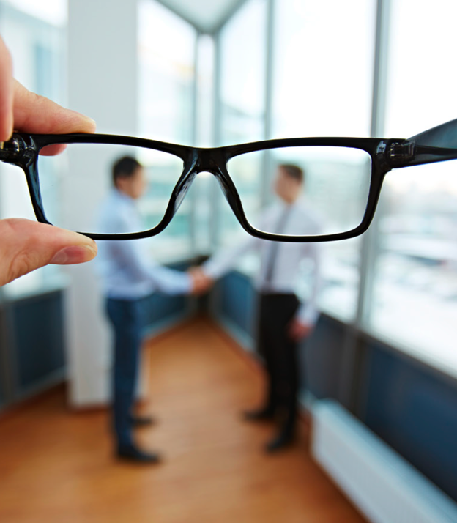
What is Unconscious Bias?
A bias that we are unaware of, which happens outside of our control, and happens automatically.
Our brains make quick judgments and assessments of people and situations based on your past experiences, culture, background or exposure to media.
These hidden preferences or prejudices can affect nearly every decision we make.
Notes:
First teacher of color, first doctor that wasn’t a white male,

Slide 8
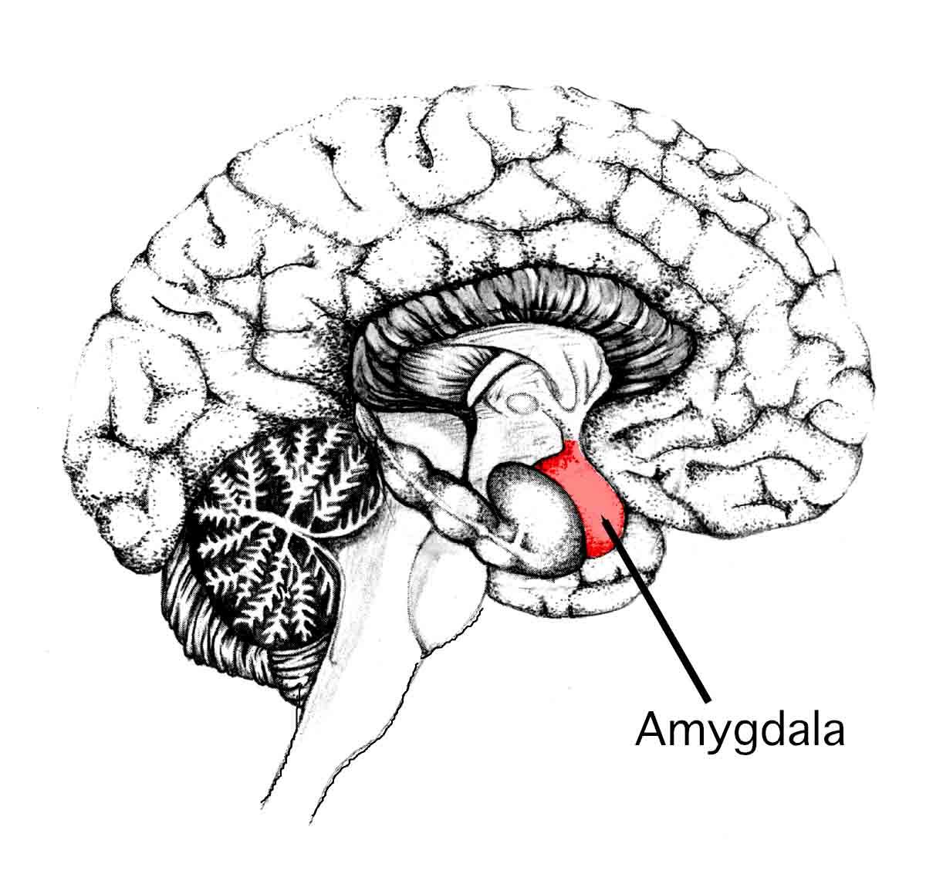
What is Unconscious Bias?
Most unconscious bias is determined in the amygdala of our brains
Activated in fight or flight responses
10,000,000 bits/sec retinal nerve vs. 40 bits/sec conscious mind
Oldest part of our brains
Plays primary role in decision-making, memory processing and emotions

Slide 9
What Causes Unconscious Bias?
We are deeply influenced by our life experience & social conditioning
Media portrayals
Where and how we were raised
What we were exposed to at a young age
We seek out patterns (social cognition)
Our brain naturally looks for patterns and associations to reach decisions
We like to take shortcuts
We are inundated with more info than we can conceivably process; mental shortcuts make it faster and easier for the brain to sort through data

Slide 10
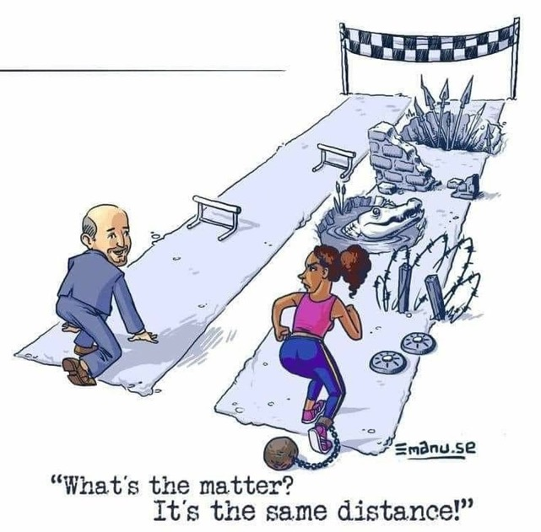
What is Privilege?
Those with privilege enjoy some special right or advantage that other people don't have.
People can be privileged in many ways, but it always means that they're getting some unusual deal that others probably aren’t getting and often envy.
Being privileged doesn’t mean you didn’t work hard for what you have; it means those without the same privilege must work much harder to get to the same place.

Slide 11
Why Should We Care?
Hire & retain the best talent
Diverse teams tackle complex problems better and are move innovative
Unconscious bias effects:
Commitment
Job satisfaction
Workplace tensions
Feelings of belonging and worth

Slide 12
Why Should We Care?
Companies with high gender diversity are 15% more likely to outperform their competitors.
Racially diverse companies are 35% more likely to have higher financial returns.
$
$
15%
35%
Gender Diversity
Ethnic Diversity

Slide 14
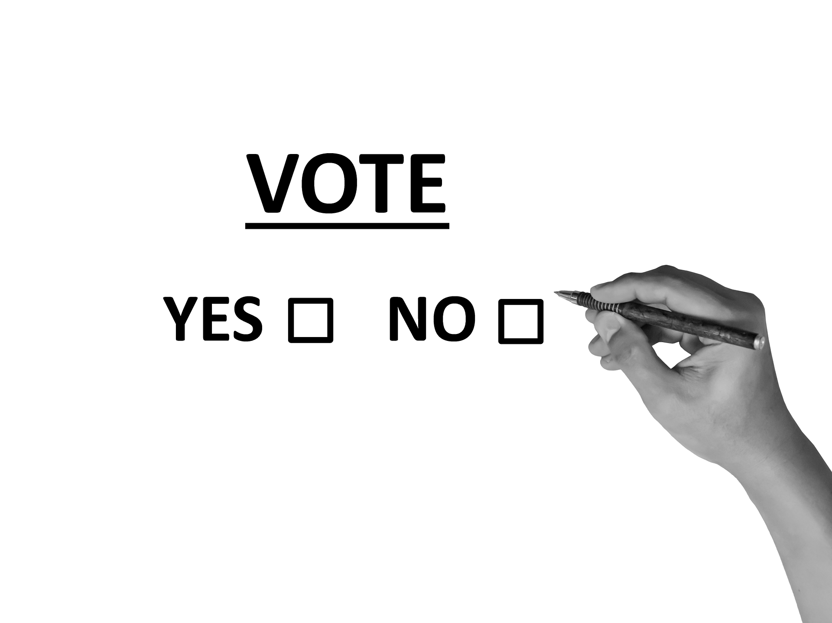
Let’s Take a Quick Quiz

Slide 15
Ask Yourself (and others)…
Yes No
I can count on looking at the top level of management in any organization and seeing people who belongs to my identity category: my gender, race/ethnicity, sexual orientation, religion, disability status.
I can count on my coworkers wanting to include me in their conversations.
I can display photographs of my family or my personal life without worrying that it will invite negative perceptions.

Slide 16
Ask Yourself (and others)…
Yes No
I can count on my coworkers assuming that we will have things in common that unite us.
I can speak up within my work group and not worry that others will attribute something about what I said to my identity category (gender, race/ethnicity, sexual orientation, religion, disability status); instead, they will focus on the idea itself.
I can trust that my behavior will be viewed as only my own and not representative of a wider group.

Slide 17
Ask Yourself (and others)…
Yes No
I can trust that I won't be talked over in a meeting, and I can speak up without being interrupted.
I can challenge the status quo and be perceived positively as a potential leader.
I can talk about what I did over the weekend without worrying about what it will reveal about me.

Slide 18
Ask Yourself (and others)…
Yes No
I can trust that my peers and colleagues assume I have earned my position through my abilities.
I can mention my family responsibilities without being perceived as a less valuable contributor.
I can trust that I will get credit for my ideas and contributions.

Slide 19
Ask Yourself (and others)…
Yes No
I feel comfortable asking questions or asking for help because my coworkers assume that I am competent.
I can choose not to participate in "housekeeping" efforts, such as organizing team social functions or workspace clean-up efforts, without feeling pressure from my peers over it.
I can feel comfortable being my preferred self, showing my true personality, at work without worrying that people will judge me negatively for it.

Slide 20
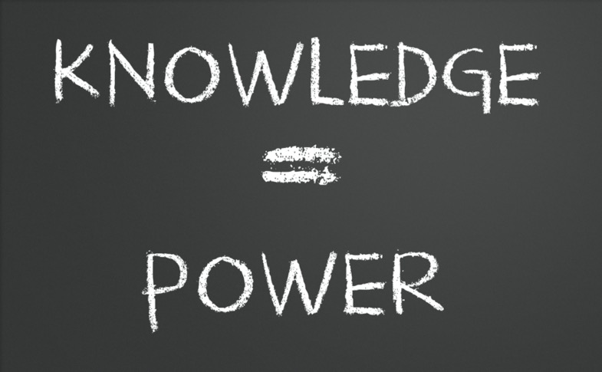
Addressing Unconscious Bias
Make sure employees understand exactly what unconscious bias is, when it happens, and the ways it can impact your business decisions.
Develop a step-by-step plan for addressing unconscious bias in your firm along with ways to increase diversity and become truly inclusive and equitable.

Slide 21
Addressing Unconscious Bias
Train employees on how to recognize behavior that needs to be challenged and highlights actionable steps for employees to take.
Often this has more impact when someone outside the firm does the training.
Create a workplace where employees are encouraged to speak freely and where they are open to discussion without judgment.
The topic of unconscious bias is important in itself, but the overall effect it has on your firm’s culture is critically important.

Slide 22
Addressing Unconscious Bias
Consider implementing blind hiring where portions of the resume that can identify the race, sex and other identifying features of the applicant are hidden until the time of the interview.
According to a landmark study by the National Bureau of Economic Research, all else being equal, resumes with “white-sounding” names (the study suggests “Emily Walsh” and “Greg Baker”) got nearly 50 percent more callbacks than those with “black-sounding” names (the study suggests “Lakisha Washington” and “Jamal Jones”). Moreover, a 2014 study published in the Proceedings of the National Academy of Sciences found that managers of both sexes were twice as likely to hire a man as a woman.

Slide 23
Overcoming Unconscious Bias
Identify Bias
Take Implicit Association Test developed by Harvard
www.implicit.harvard.edu
Free tool identifies patterns including similarities in the people you socialize with or tend to hire.
Patterns don’t automatically indicate bias, but if you see a pattern, it would be wise it examine it further.

Slide 24
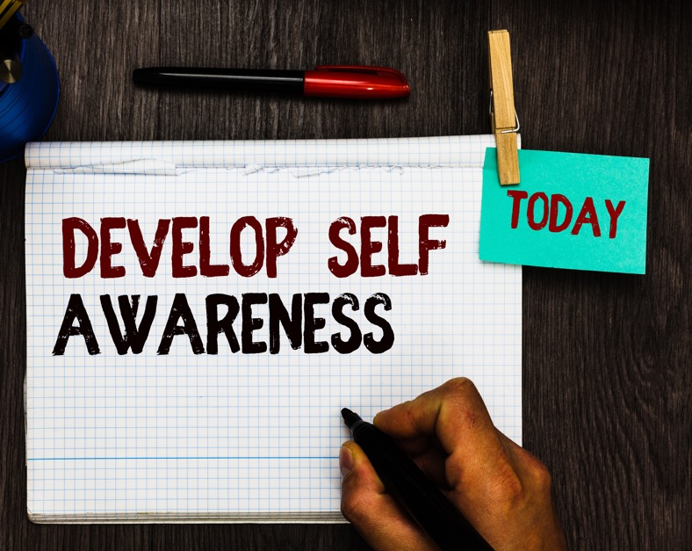
Overcoming Unconscious Bias
Become More Self-Aware
Are you basing decisions on snap judgements?
You can’t keep thoughts from surfacing, but you don’t have to continue that line of thinking.
Pause your thoughts and examine to better understand where they’re coming from and why.
Practicing this will help you become more self-aware and question your judgements will become second nature.

Slide 25
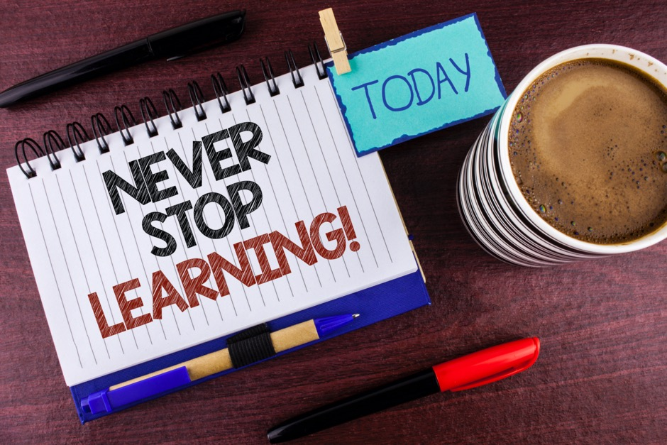
Overcoming Unconscious Bias
Educate Yourself & Others
We all have unconscious biases; it is important for firms to train their team members on how to identify and overcome it.
By understanding how others think and reinforcing positive behaviors, we can create a more fair, inclusive and equitable firm.

Slide 26
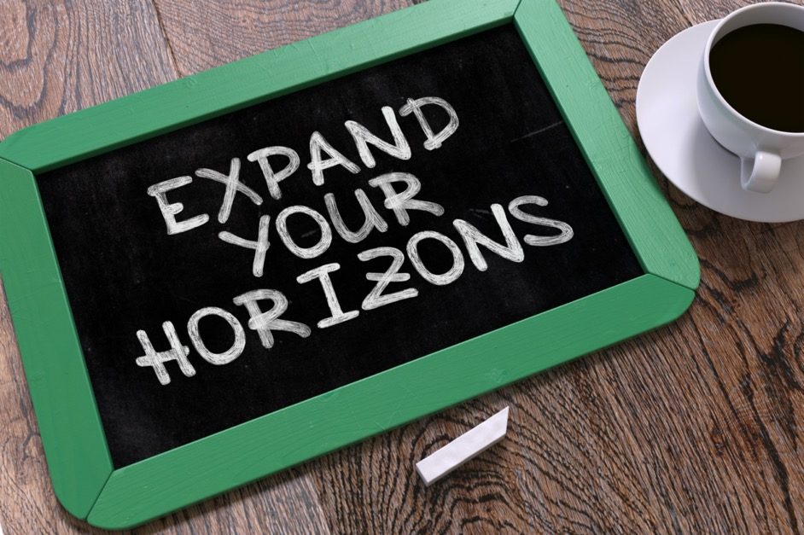
Overcoming Unconscious Bias
Branch Out
If you find that a particular group makes you uncomfortable, make a conscious effort to learn more about that group.
Expose yourself to positive images and other info related to that group.
Be open to change.

Slide 27
Remove Bias In Performance Reviews
It is difficult for team managers to reliably rate their employees.
Only 1/3 of employees who score high in their performance reviews are the organization’s top contributors
61% of a performance review rating is a reflection of the manager, not the employee.
The various biases that impact performance reviews is called the idiosyncratic rater effect (IRE).
1/3
61%
Notes:
When one person’s unconscious bias is applied to performance appraisals, it can lead to inaccuracy, favoritism and even unfair treatment of employees, based on their age, sex, race or sexual orientation.

Slide 28
IRE: Halo Effect
Occurs when our impression of someone is skewed by one positive trait, leading us to make generalizations about them as a whole.
Example: If an employee is outgoing and easy to get along with, their manager may unintentionally ignore that they have consistently failed to job requirements.

Slide 29
IRE: Halo Effect
How to Overcome:
Develop an evaluation matrix that encourages managers to look at a broad range of traits and skills & weight them evenly.
Provide tools to track common (or commonly overlooked) concerns, like attendance or missed deadlines.
Embrace the bias by helping managers develop soft skills so they can help their employees use their strengths to overcome their weaknesses.

Slide 30
IRE: Horns Effect
Occurs when you focus on a negative trait and you allow that to overshadow the many positive traits a person may have.
Example: A manager values a clean work area and a peaceful environment while working, but their employee is messy and boisterous. This may produce an unfair evaluation (especially without specific workplace guidelines).

Slide 31
IRE: Horns Effect
How to Overcome:
Look at positive traits first; this will help put negative traits in proper perspective.
Develop an evaluation matrix that encourages managers to look at a broad range of traits and skills & weight them evenly.
Give managers the soft skills to develop employee weaknesses into strengths.

Slide 32
IRE: Recency Bias
Occurs when people tend to emphasize very recent events or observations instead of looking at events over time.
Example: A manager may place the primary focus on recent mistakes (or successes) rather than aggregating performance throughout the year.

Slide 33
IRE: Recency Bias
How to Overcome:
Have managers hold weekly or monthly one-on-one with a clear goal.
Document these short meetings so well that they can replace or augment your annual performance review process.
Frequent check-ins encourage managers to focus on improving present and recent realities.

Slide 34
IRE: Similarity Bias
Occurs because people are more likely to imitate cultural models that are similar to that person, based on specific traits.
Example: Hiring someone because they could be fun to work with won’t necessarily yield a productive work environment or even a good employee. A company that lacks diversity limits their innovation and growth.

Slide 35
IRE: Similarity Bias
How to Overcome:
Recognize that no one is perfect. Include a pros and cons list as an element of your performance reviews.
Develop a culture that encourages managers to diversify their team’s personalities.
Follow a strict framework and standardized structure for big conversations.

Slide 36
IRE: Contrast Bias
Occurs because people mentally upgrade or downgrade a person when comparing to a contrasting person.
Example: A manager compares an employee’s performance to other employees rather than an established company standard, giving a poor evaluation to an employee meeting goals because another employee went beyond the standard.

Slide 37
IRE: Contrast Bias
How to Overcome:
Create customized evaluations based on each job description.
Adjust written evaluation questions to compare the employee to the job description.
Compare current performance to previous performance, looking for improvements and progress toward goals.

Slide 38
Idiosyncratic Rater Effect
It is nearly impossible to eliminate Idiosyncratic Rater Effect from your performance management system.
But you can design your system to accommodate those bases and work to minimize their impacts.
Coach Best Practices: This can be a great first step in eliminating biases in your performance management.

Slide 39
Overcoming Unconscious Bias
Look Inward
Push back against your own biases before asking others to do the same. Become a role model for others.
Speak Up
Talk about your journey and identify, acknowledge and address areas for improvement.
Keep Learning
The more you know, the more you can change in yourself, your co-workers and your firm.
Know Your People
Connect to others and learn how they experience your workplace. Don’t assume you know how others feel or experience the world.
Empower Your Team
Give employees power in making change and create a culture where this is encouraged and embraced for the greater good of the firm.
Break the Cycle
We all have unconscious bias. Hold people accountable & rely on structures to modify their judgments and behaviors rather than feelings.
Be Open-Minded
Intentionally mentor and sponsor people who are not like you. Give others who are not like you a chance to teach you and learn from each other.
Nurture Alliances
Connect to others outside of your firm who have succeeded and learn from them. Find people within your firm who are passionate about change and engage them.
Stay Committed
Our biases will not disappear. They will change when we confront them. Keep working to overcome them and helping others do the same.
And get help when you need it! Often those outside your firm can tackle uncomfortable issues much easier and more effectively.

Slide 40
Further Reading
Five Real World Examples of Unconscious Bias
Can Blind Hiring Improve Workplace Diversity
Unpacking the Invisible Knapsack
4 Unconscious Biases That Distort Performance Reviews
How to Be an Antiracist
White Fragility
Overcoming Unconscious Bias to Create a More Inclusive Firm

Slide 41
Questions?
Bonnie Buol Ruszczyk
bbr companies & Rally Rounds
bonnie@bbrconsults.com
404-423-4433
bbrcompanies.com rallyrounds.com

